Slide 1

forester: A Novel Approach to Accessible and Interpretable AutoML for Tree-Based Modeling
2nd International Conference
on Automated Machine Learning:
AutoML 2023 Conference, Potsdam
Hubert Ruczyński
Warsaw University of Technology

Slide 2
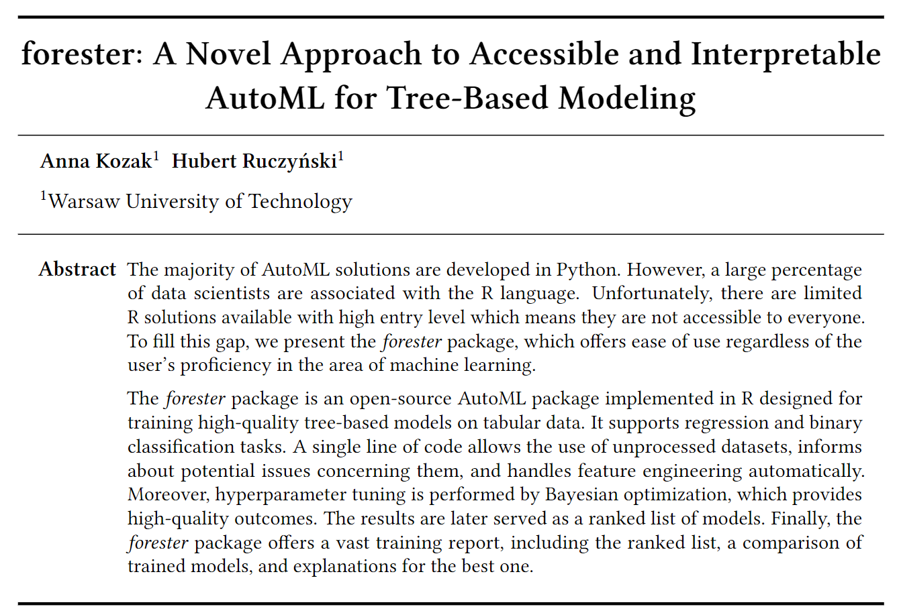

Slide 3
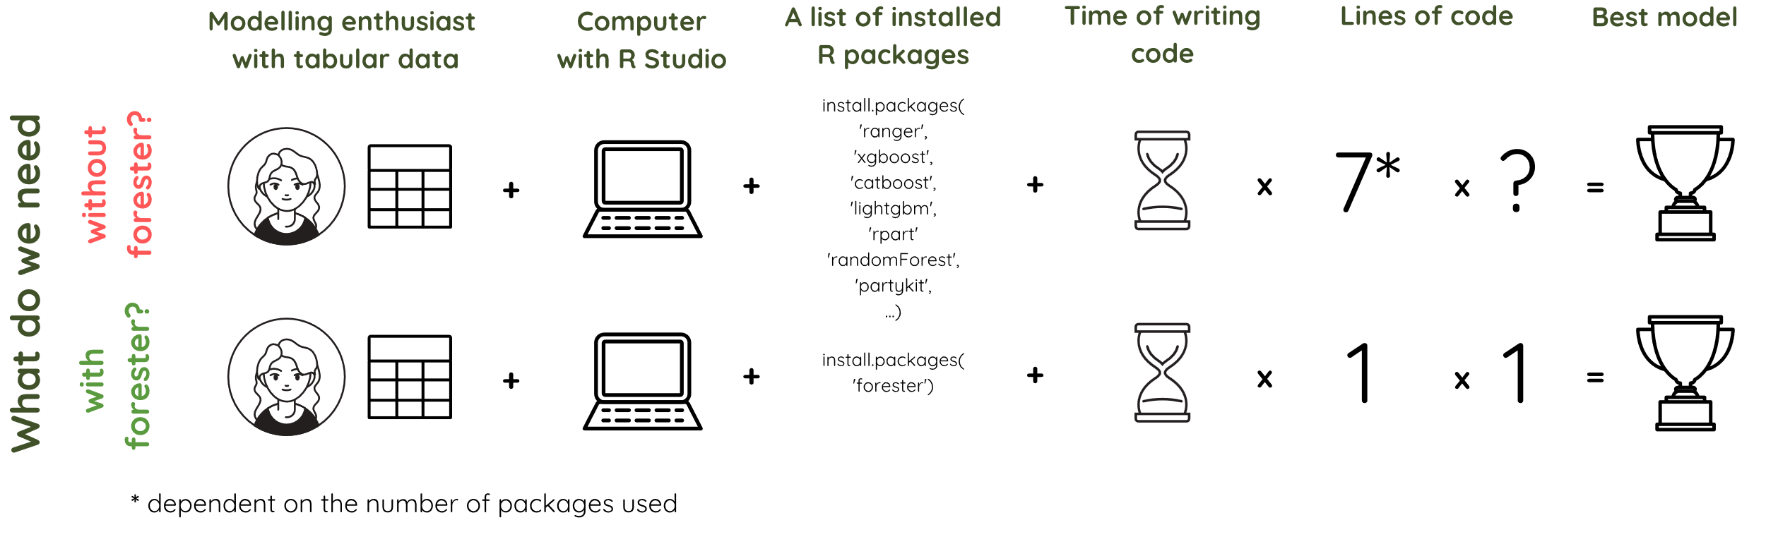
How to build models in R?
How to use it?
library(forester)
data(`lisbon`)
train_output <- train(lisbon,`Price`)

Slide 4
What is the forester?
The forester is an AutoML tool in R for tabular data regression and binary classification tasks*, that wraps up all machine learning processes into a single train()function, which includes:
1. rendering a brief data check report,
2. preprocessing the initial dataset enough for models to be trained,
3. training 5 tree-based models with default parameters, random search and Bayesian optimization,
4. evaluating them and providing a ranked list.
However, that’s not everything that the forester has to offer. Via additional functions, the user can easily explain created models with the usage of DALEX or generate one of the predefined reports including:
1. information about the dataset, 2. in-depth parameters of trained models, 3. visualizations comparing the best models, 4. explanations of the aforementioned models.

Slide 5
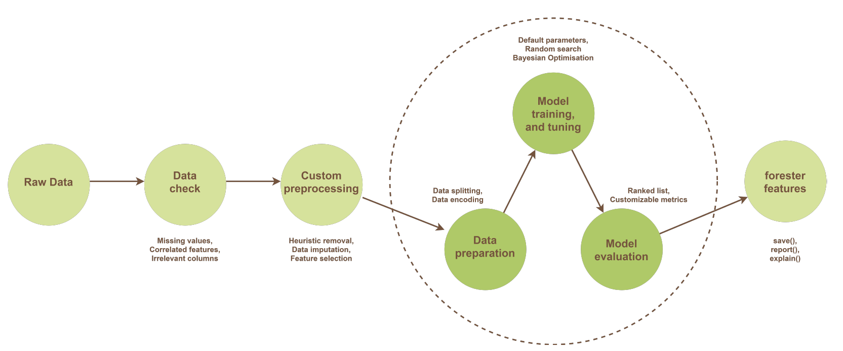
forester pipeline

Slide 6
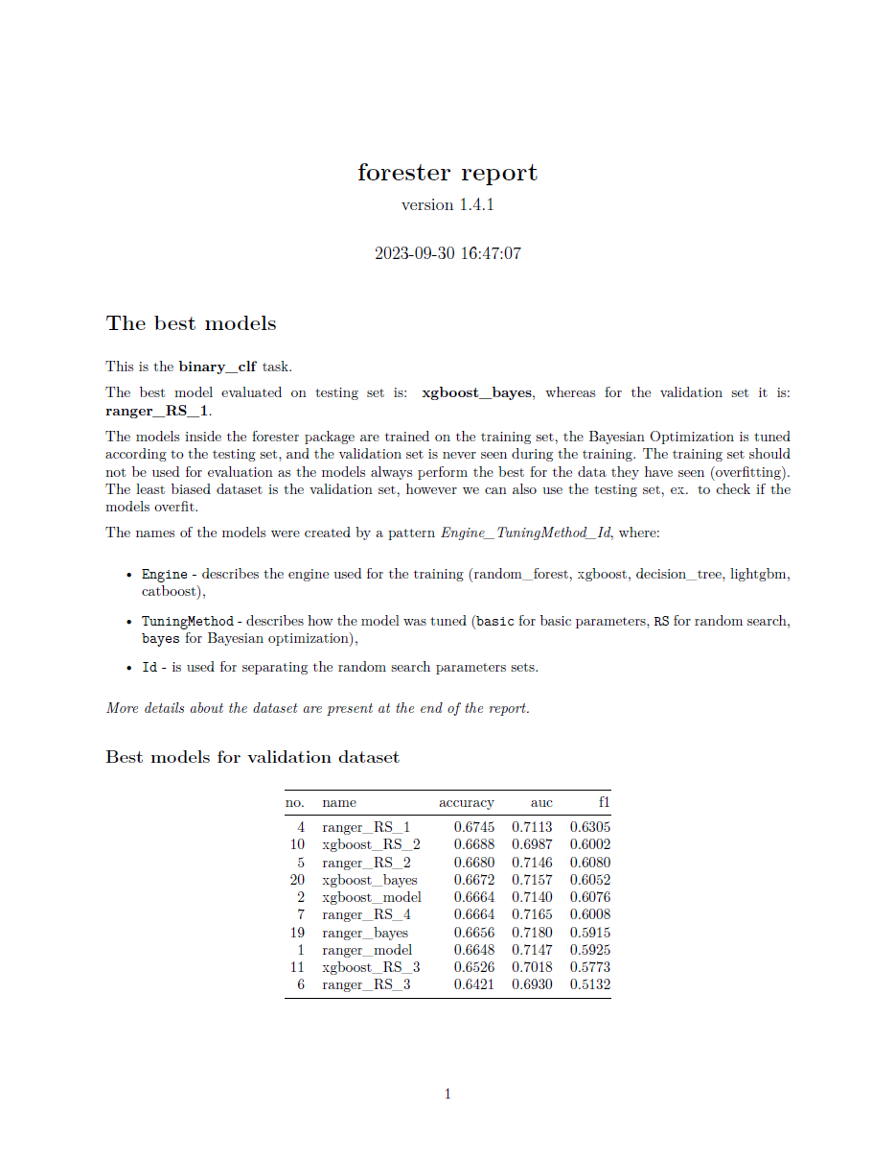
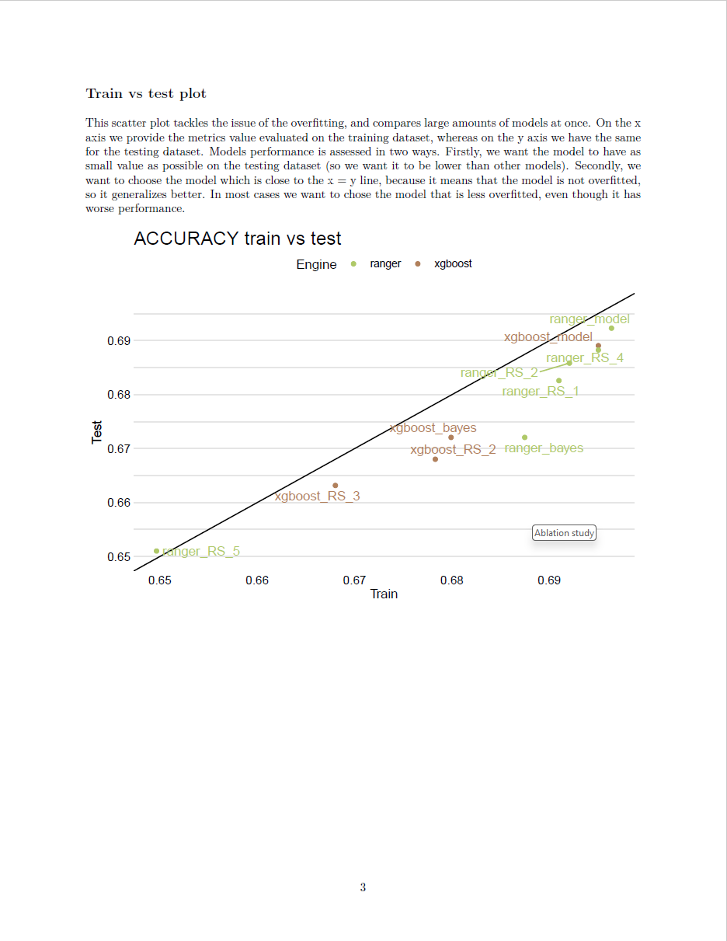
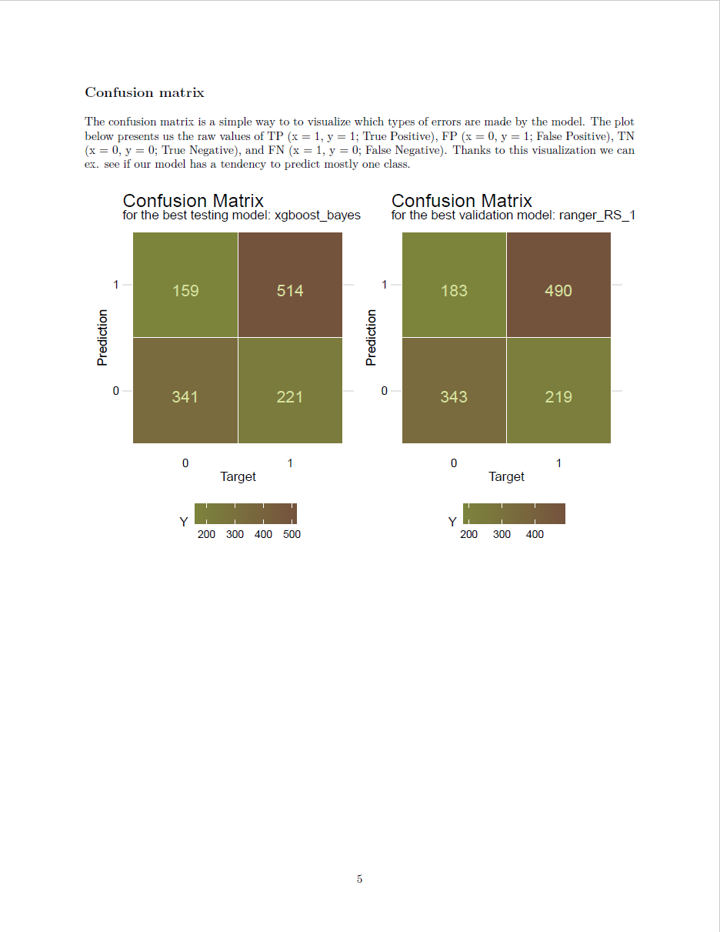

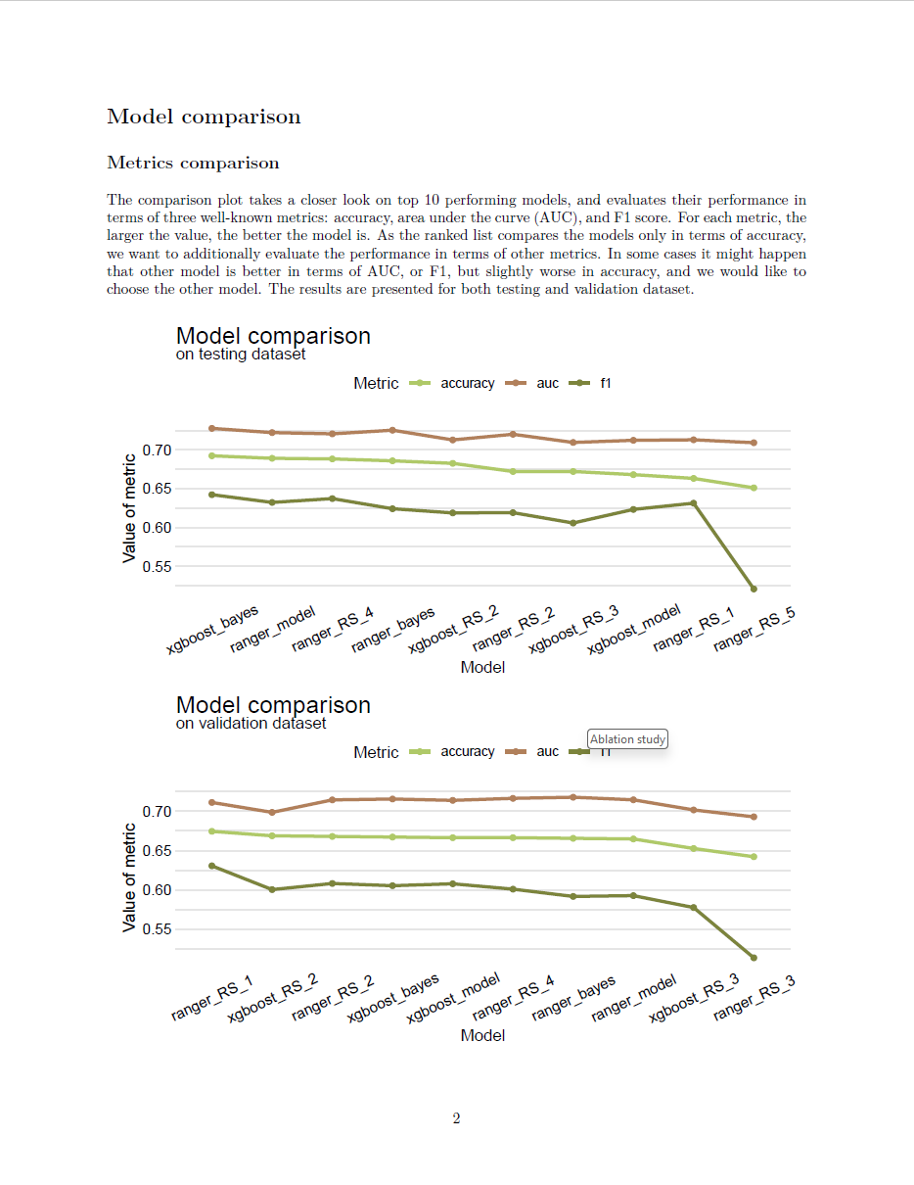
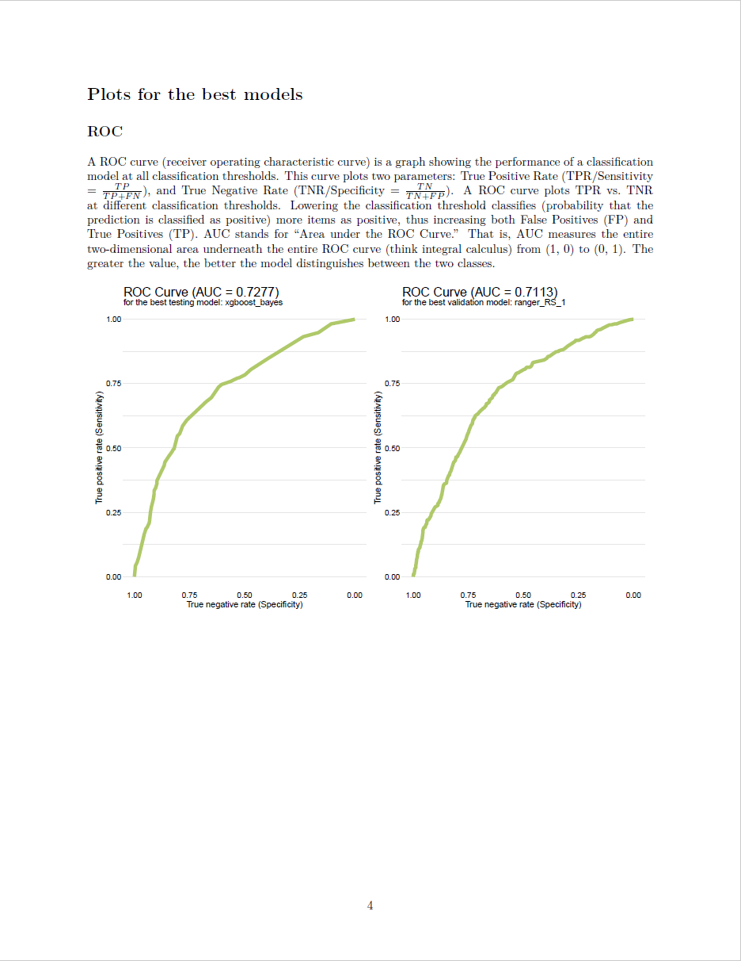
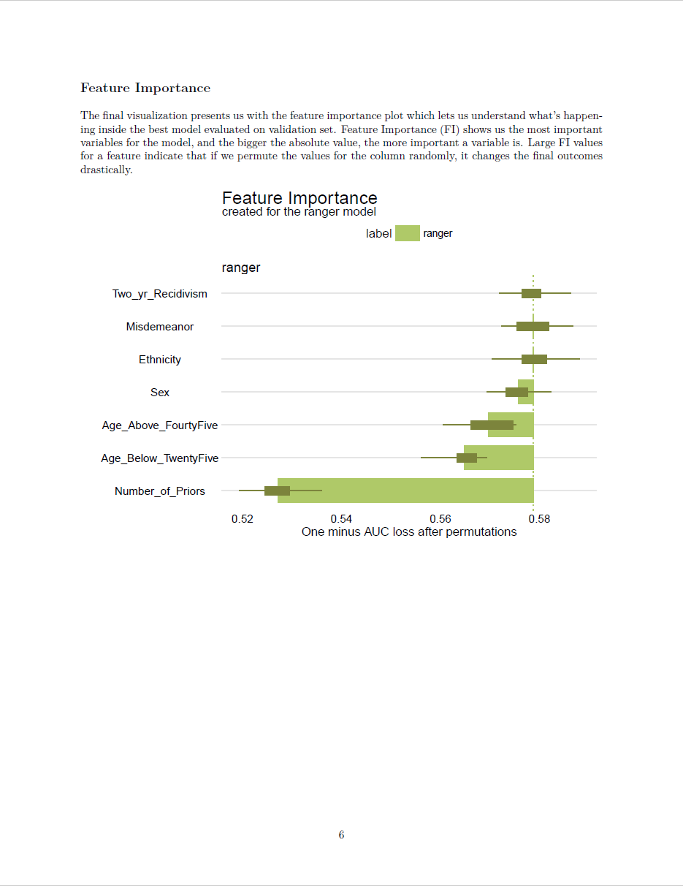
Automatic reports and XAI

Slide 7
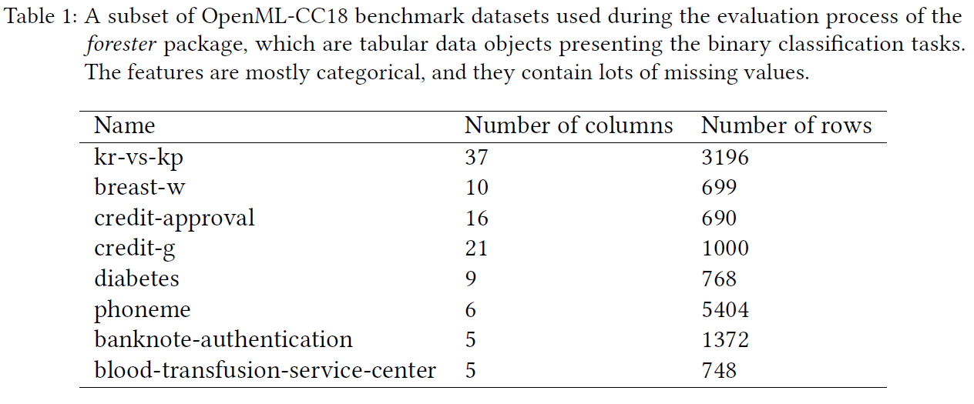
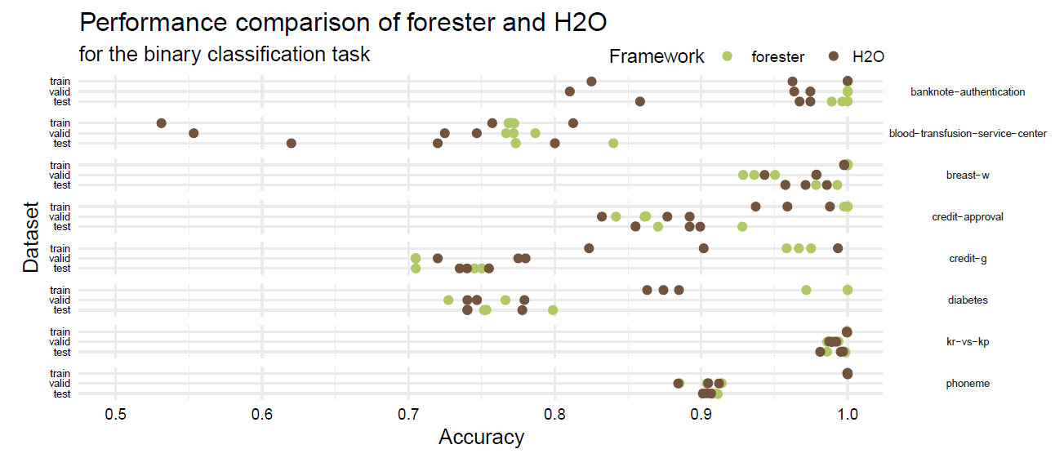
Evaluation

Slide 8
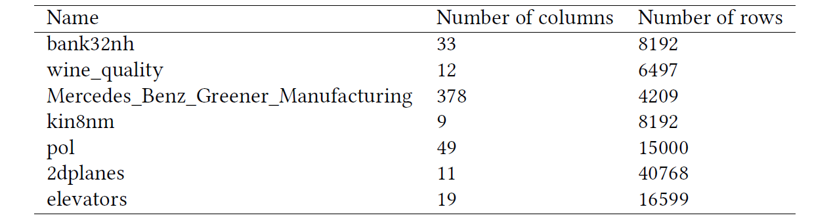
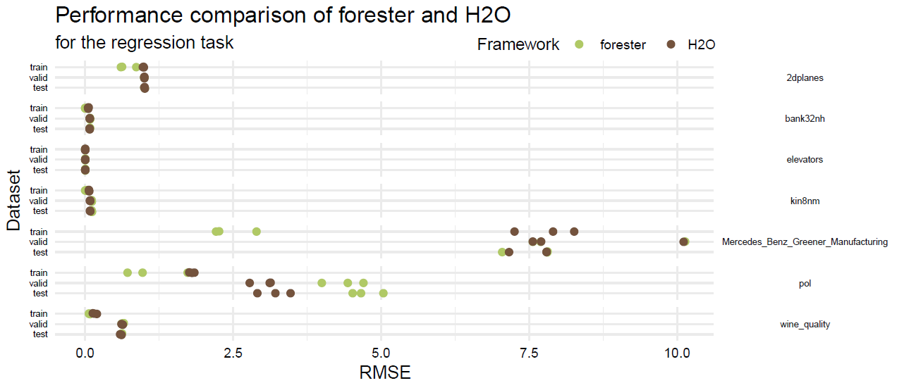
Evaluation

Slide 9
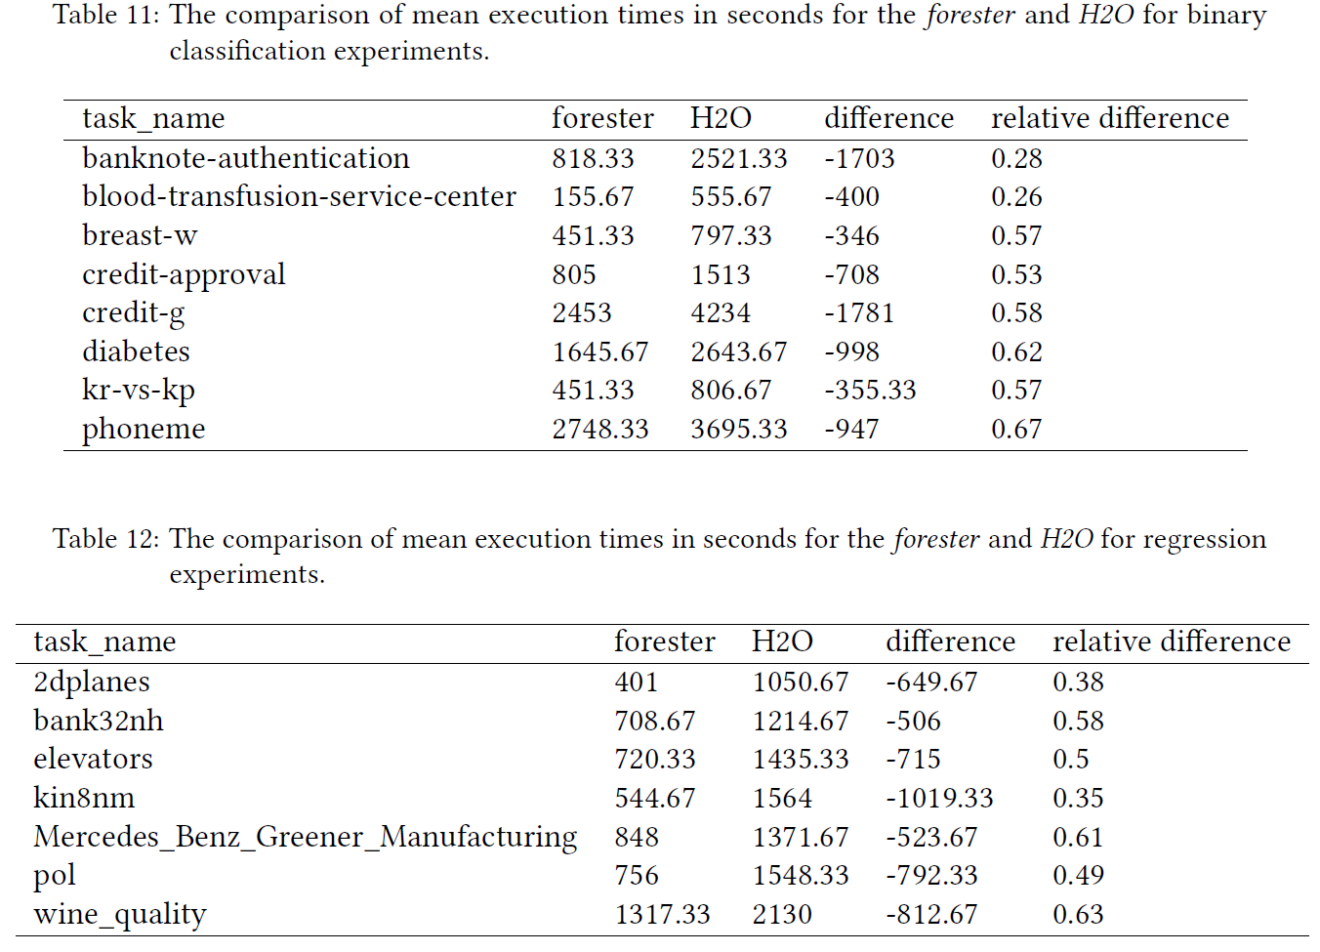
Evaluation
Notes:
s

Slide 10
Current directions
Notes:
Okay, as we still have some time I’ll also show you a more recent work and results concerning the package and my Master’s thesis

Slide 11
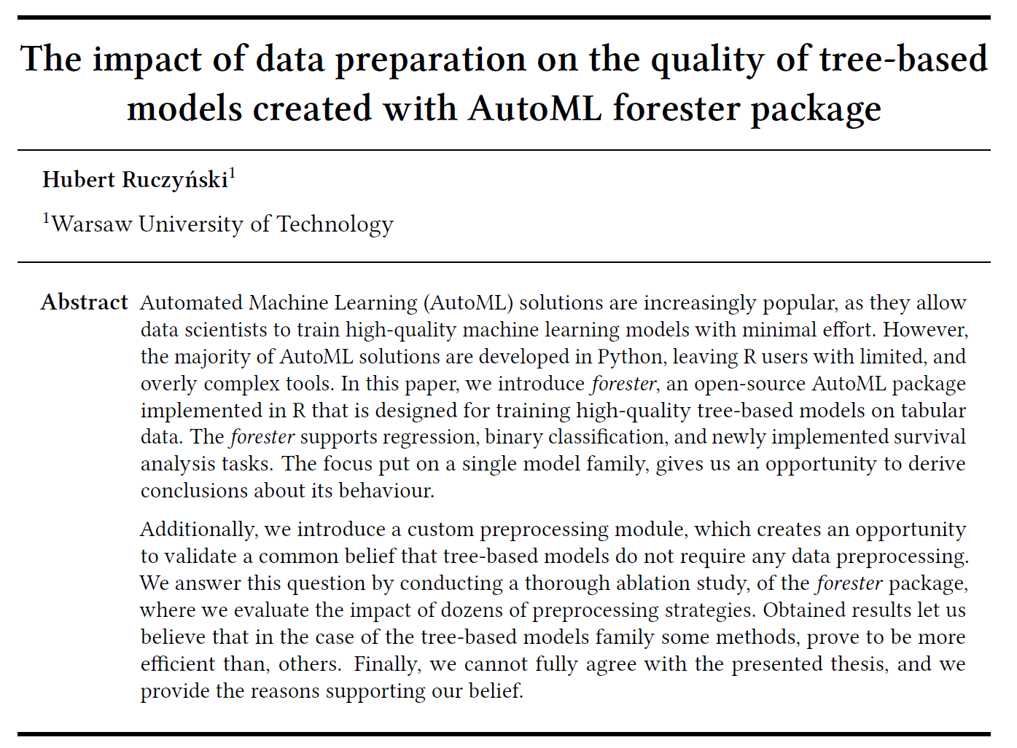
Notes:
During the last 3 months, I’ve participated in the CyberSummer@WUT-3 project, which led to major improvements in the package, as well as conducting a thorough study later described in another pre-print paper called: 'The impact of data preparation on the quality of tree-based models, created with AutoML forester package’.
In this work, we introduce, a custom preprocessing module, being a more advanced version of the previous preprocessing module, which creates an opportunity to validate the belief that tree-based models do not require any data preprocessing. Unfortunately, as the CyberSummer@WUT-3 project hasn't been evaluated yet, I cannot provide a link to the preprint on archive.

Slide 12
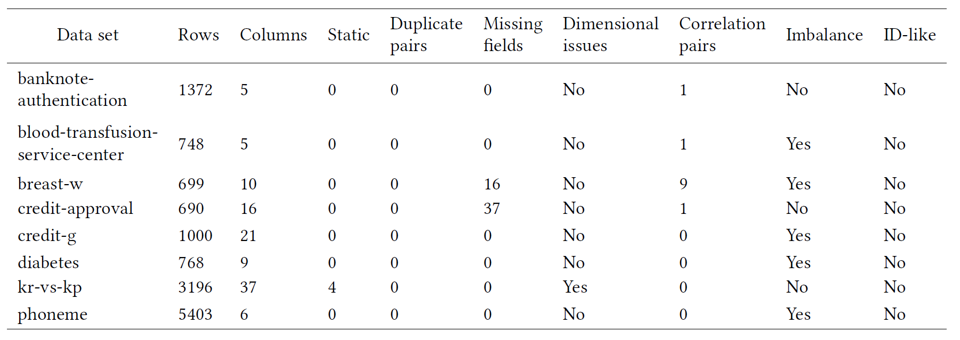
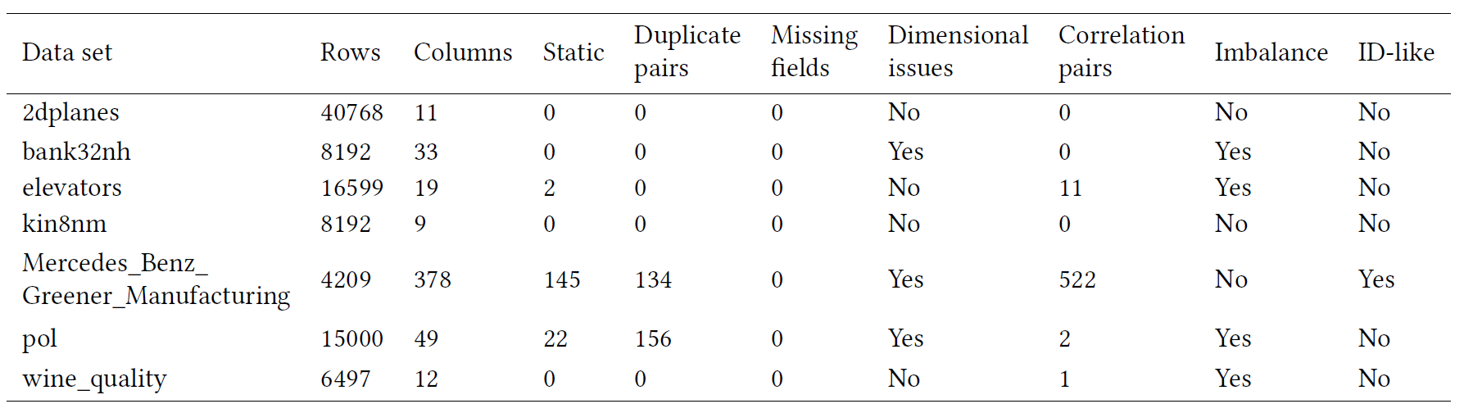
Ablation study
Notes:
The described module leads us to the biggest contribution being the Ablation study. It was conducted on the same datasets, as in the previous paper in order to provide topic continuity. Moreover, those datasets were also selected in such a way that they proposed various challenges for the custom preprocessing, thus we could evaluate their impact on the final outcomes. The issues detected via data quality check are presented in the tables from the slide. We can see that the tasks had different sizes, some of them contained static columns, we could see how many duplicate or correlated columns were present, and so on. To carry on with this study, we proposed 39 preprocessing strategies covering all options provided by the package.

Slide 13
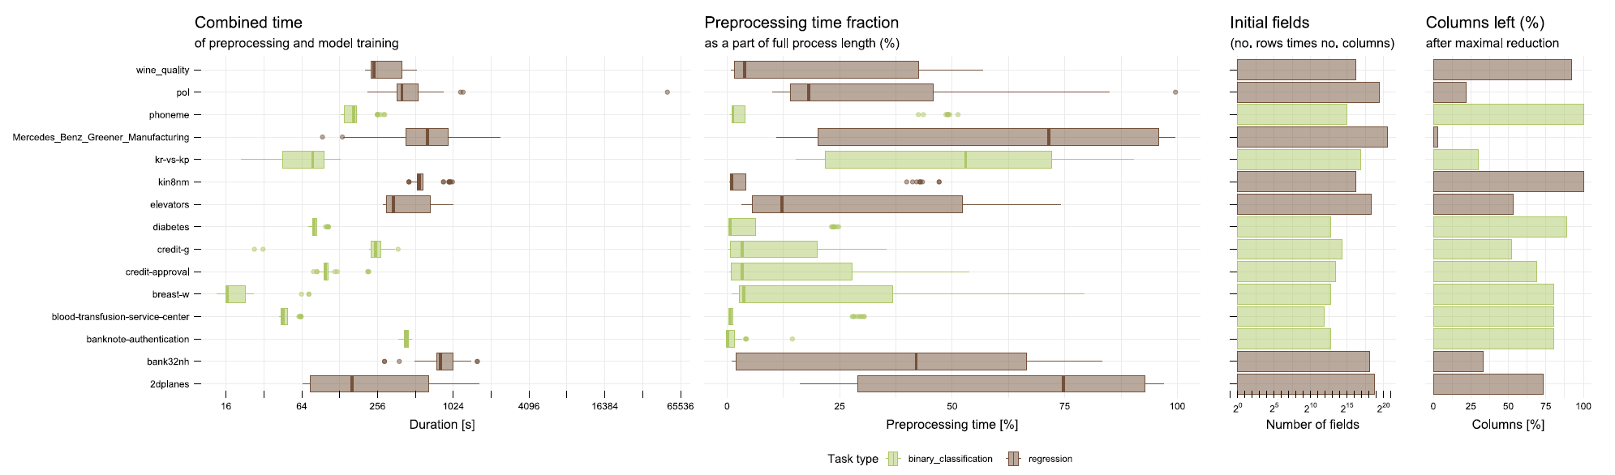
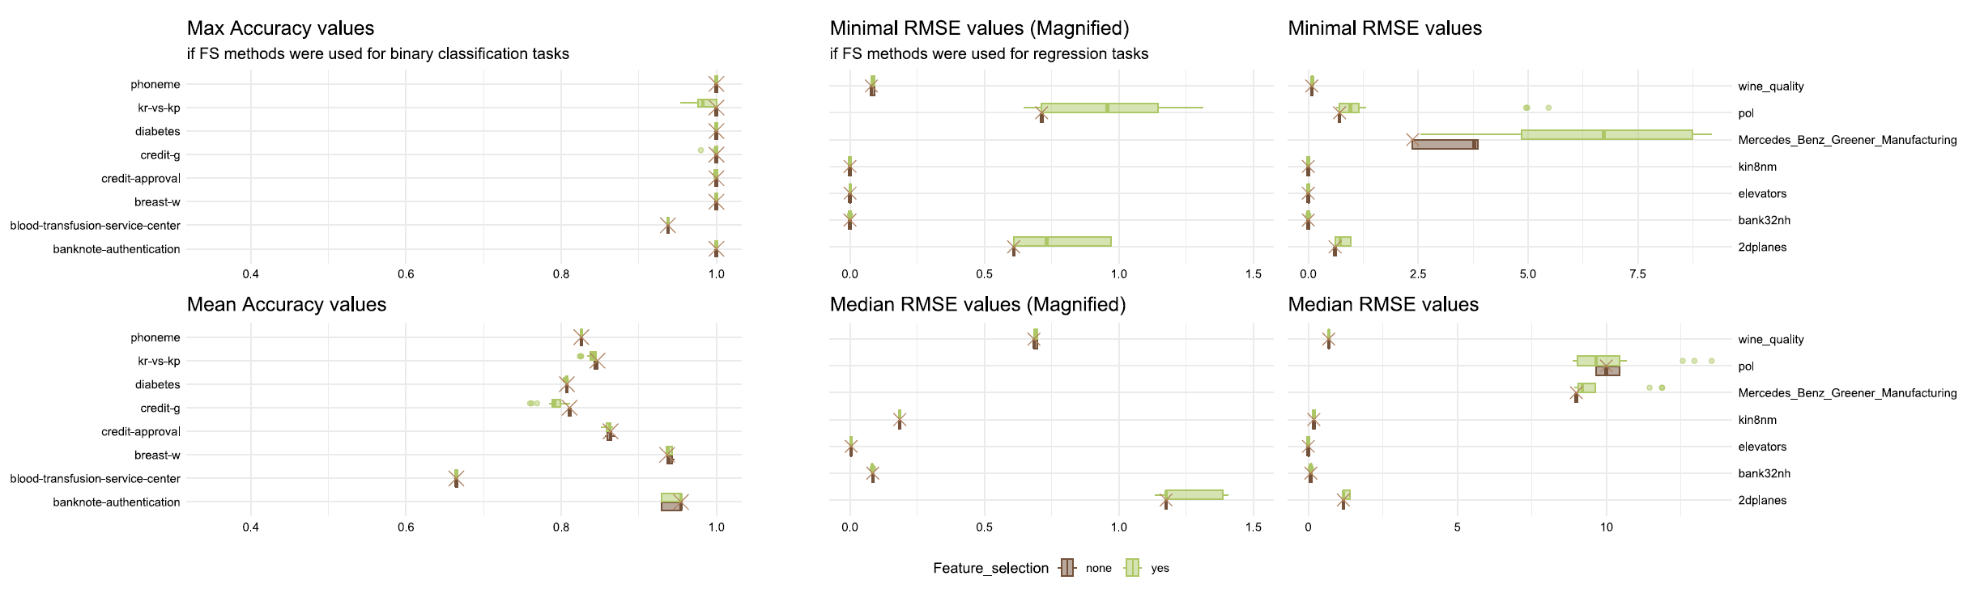
Ablation study
Notes:
Those approaches were evaluated in terms of time complexity as well as the sheer performance of trained models. As I don’t want to provide too much information about the study already, I’ll only mention that as a result we could define one group of preprocessing methods that drastically slows down the training process, and in most cases worsens the model performance. If you want to find out more, we can meet at the ML in PL conference, where I’ll participate in the poster session.

Slide 14
Master’s degree
1. Implementation of multiclass classification (MC).
2. Adding a few more datasets for current tasks.
3. Conducting preprocessing methods ablations study for MC.
4. Evaluation of various preprocessing strategies on new data.
5. Uploading forester to CRAN Repository.

Slide 15
FairPAN - Fairness (XAI)
Notes:
So, thank you for your attention. I hope you enjoyed this presentation, and I'm open to some discussion and questions regarding our topic.

Slide 16
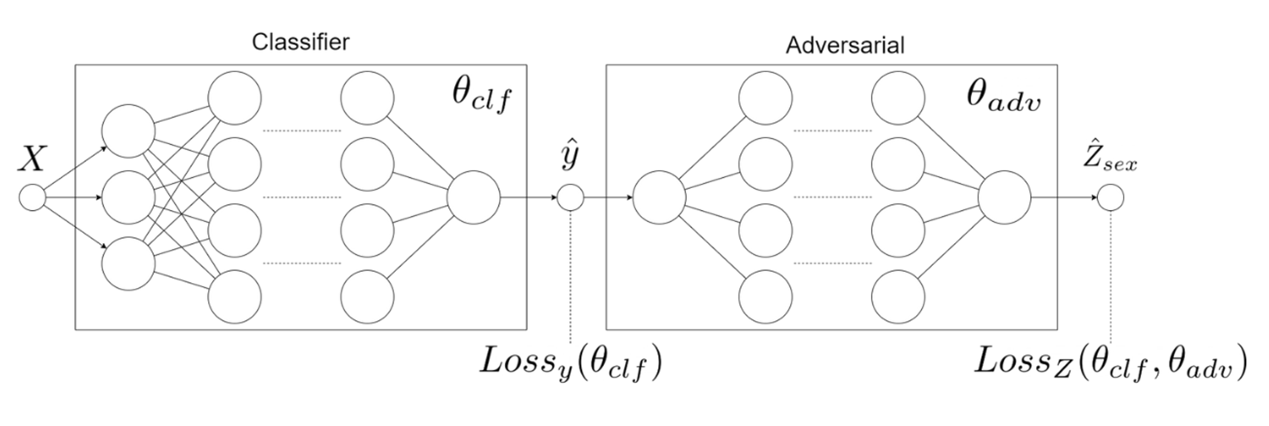
GAN architecture
Notes:
FairPANs are the solution to bring fairness into neural networks. We mimic the GANs by subsetting generator with classifier (predictor) and adversarial has to predict the sensitive value (such as sex, race, etc) from the output of the predictor. This process eventually leads the classifier to make predictions with indistinguishable sensitive values. The idea comes from blogs: Towards fairness in ML with adversarial networks (Stijn Tonk) and Fairness in Machine Learning with PyTorch (Henk Griffoen) however, our implementation in R offers slightly different solutions.

Slide 17
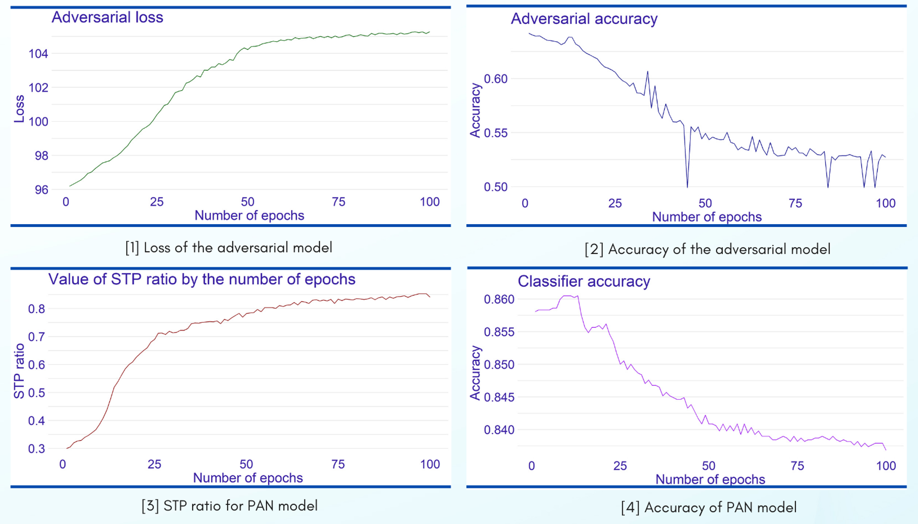
Metrics

Slide 18
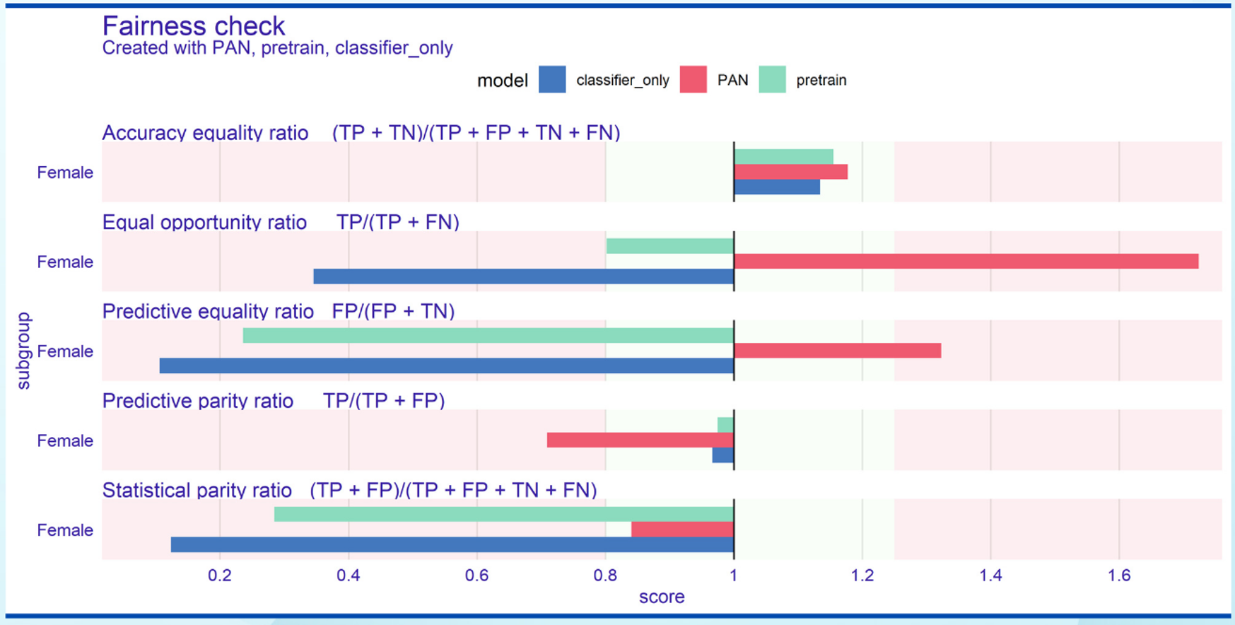
Fair results (STP)

Slide 19
Analysis of BigTech influence with memes - NLP
Notes:
So, thank you for your attention. I hope you enjoyed this presentation, and I'm open to some discussion and questions regarding our topic.

Slide 20
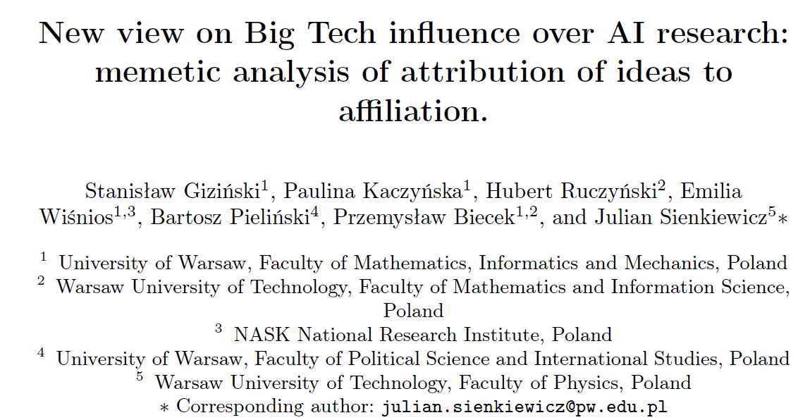

Slide 21
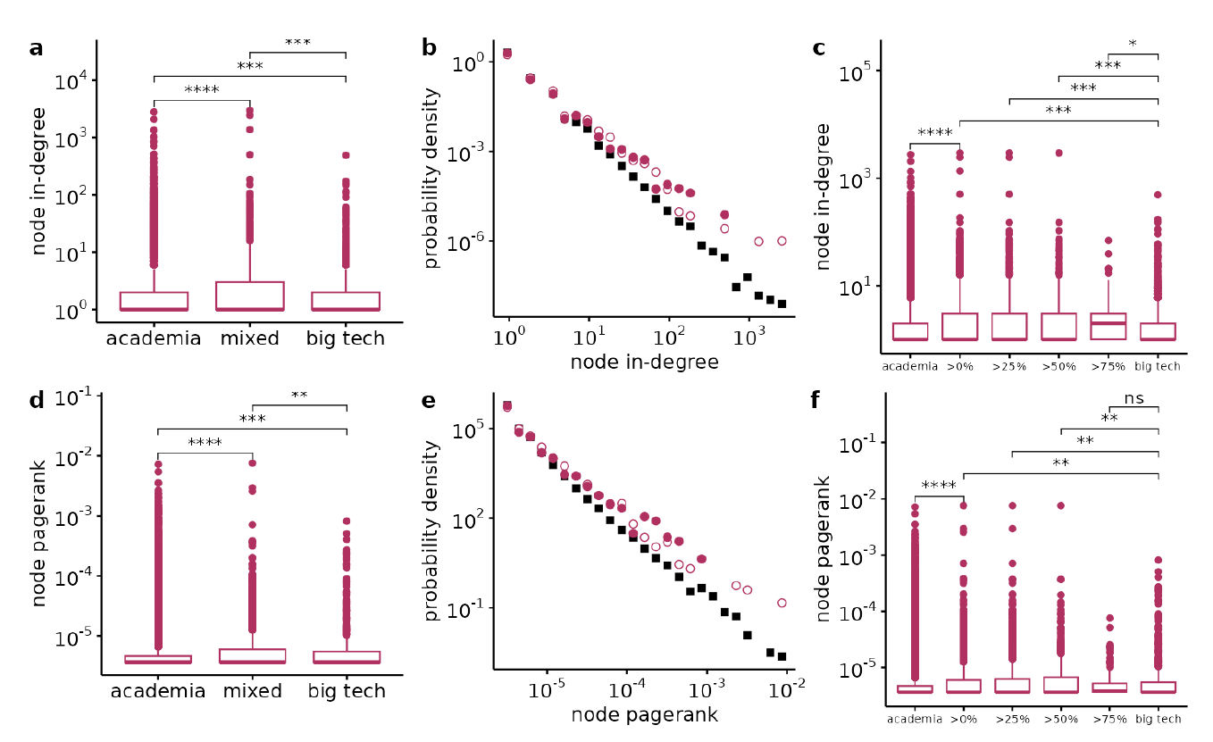
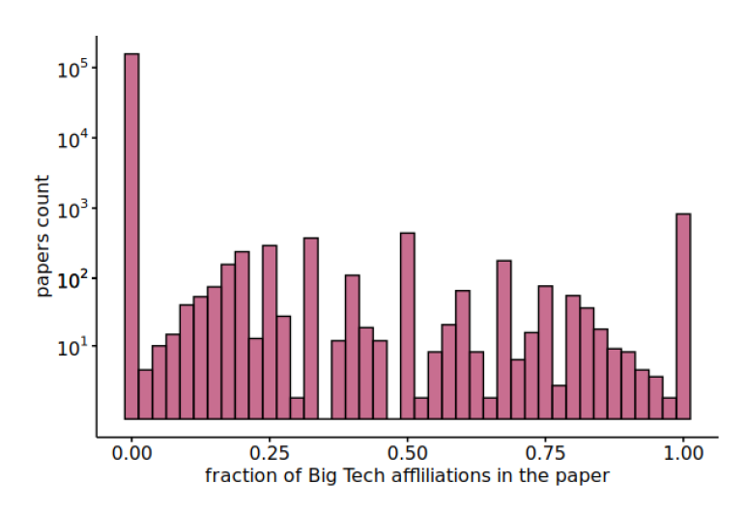

Slide 22
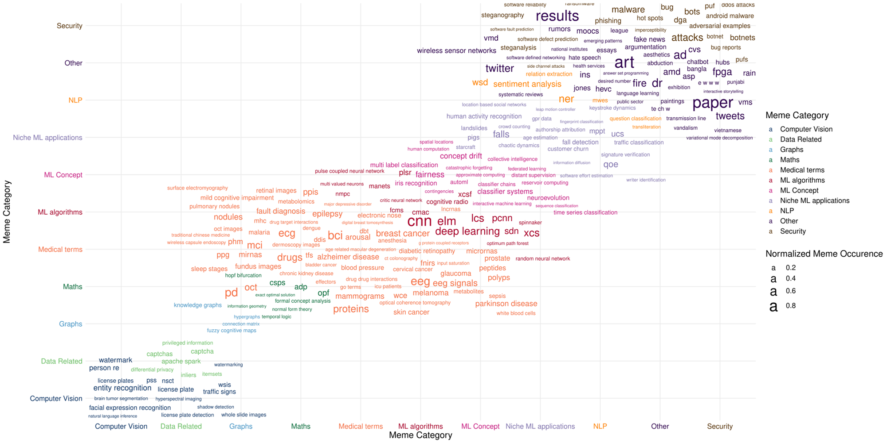

Slide 23
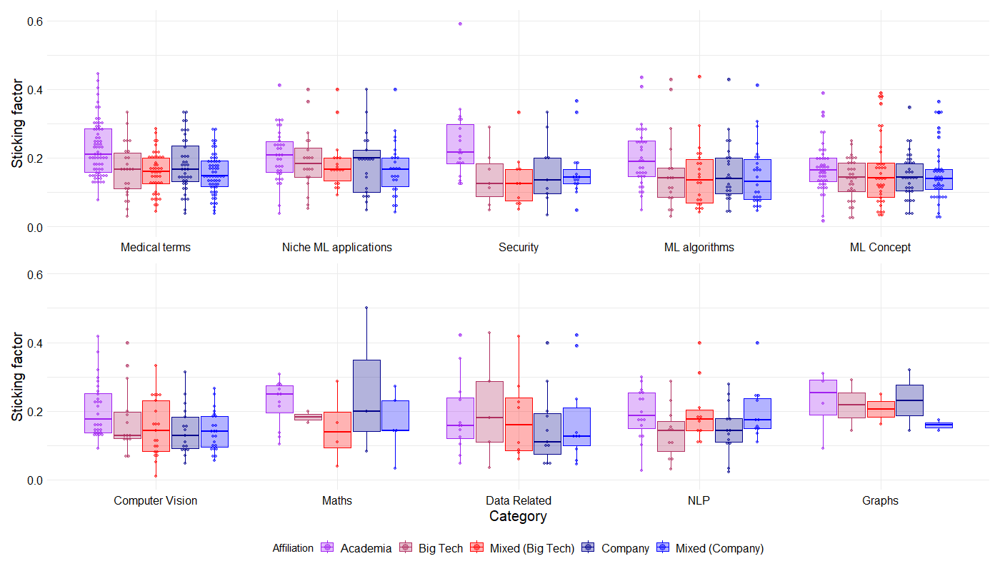

Slide 24
Data Visualization
Notes:
So, thank you for your attention. I hope you enjoyed this presentation, and I'm open to some discussion and questions regarding our topic.

Slide 25
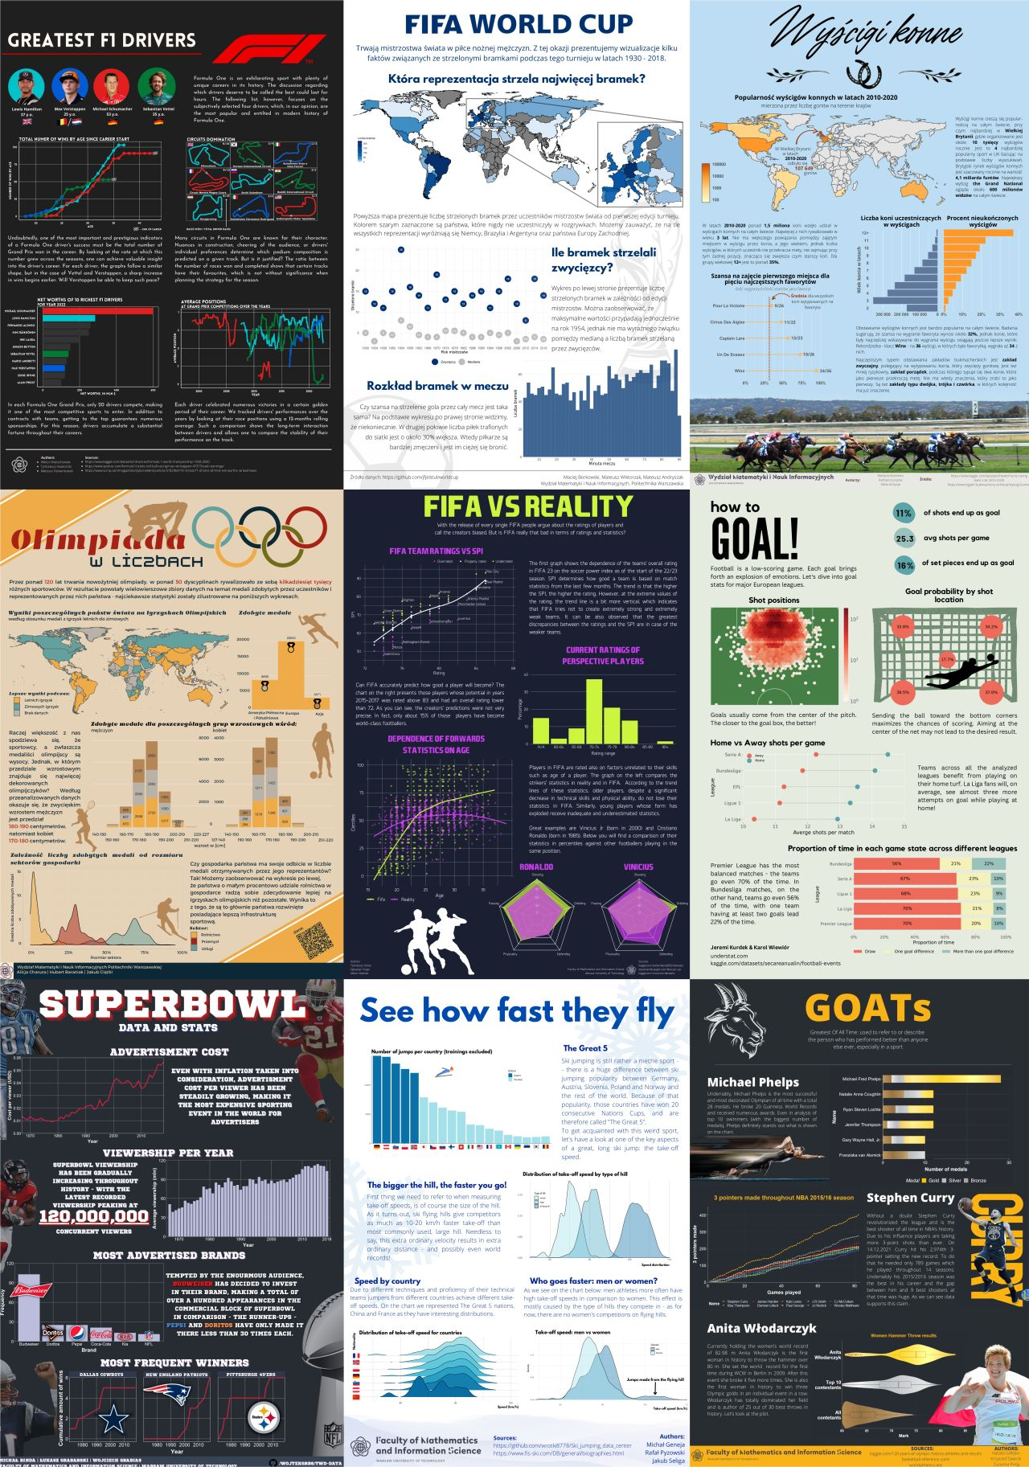
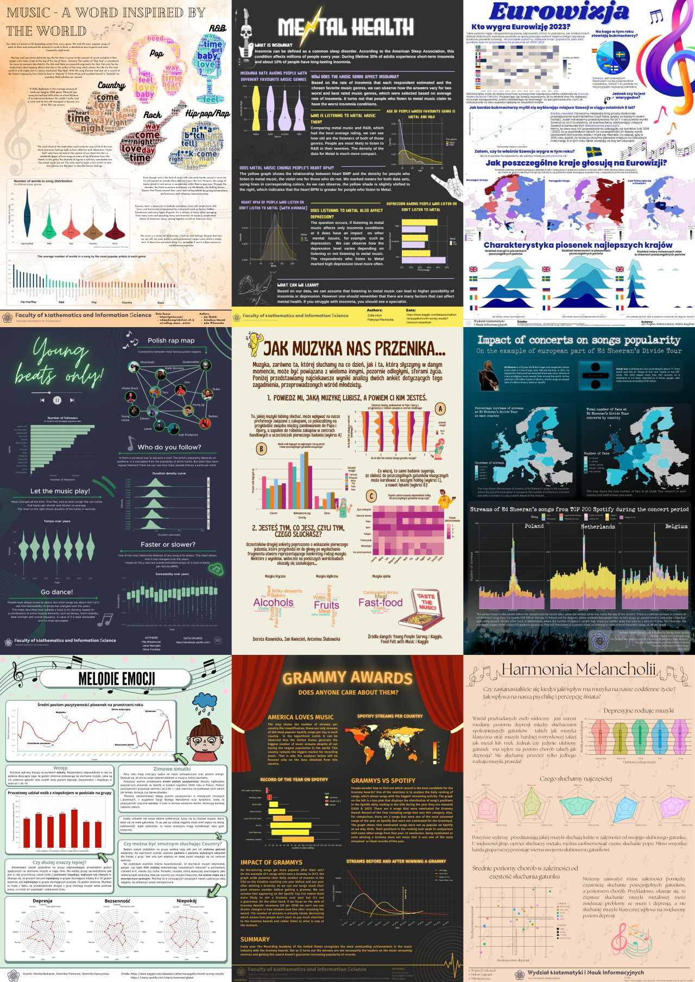

Slide 26
Posters
Notes:
So, thank you for your attention. I hope you enjoyed this presentation, and I'm open to some discussion and questions regarding our topic.

Slide 27
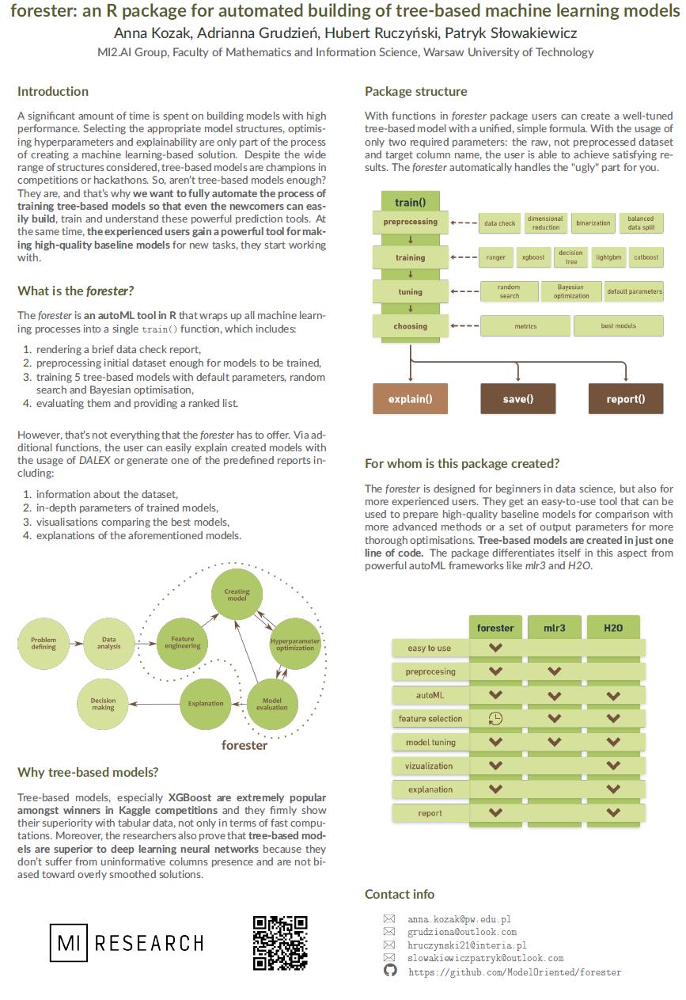
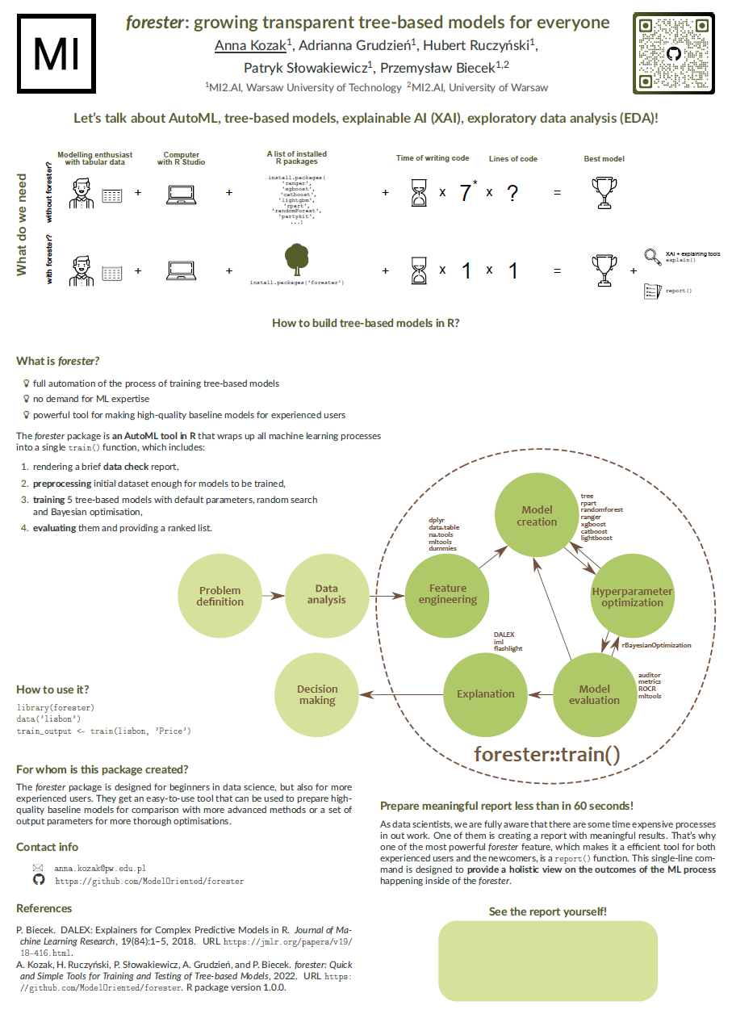

Slide 28
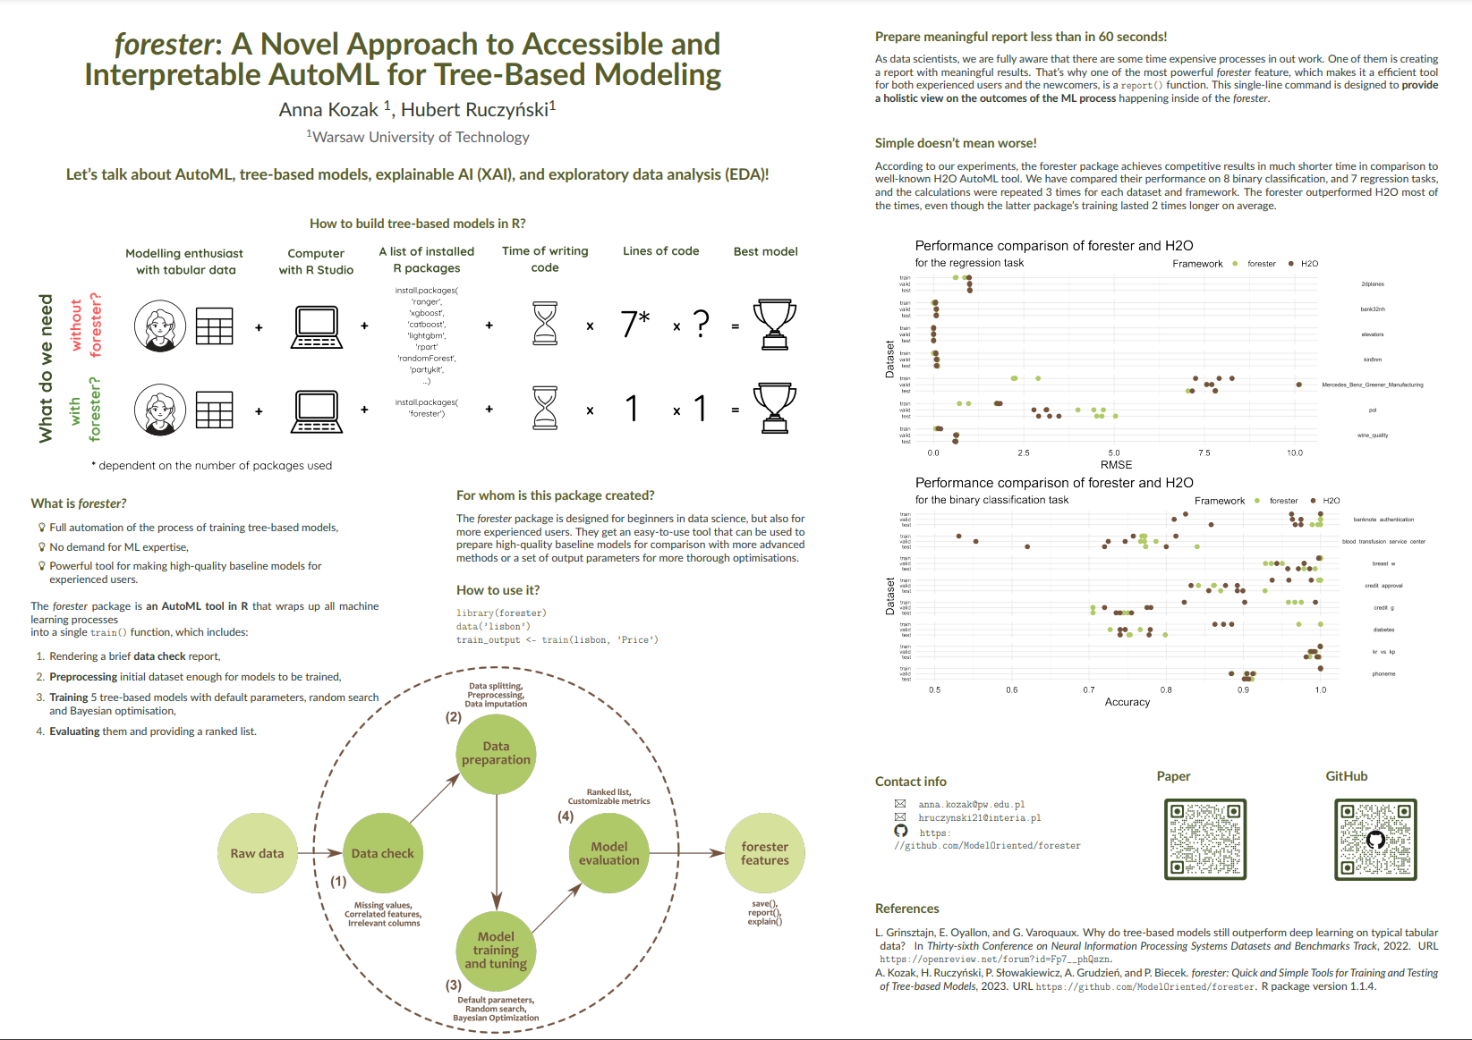

Slide 29
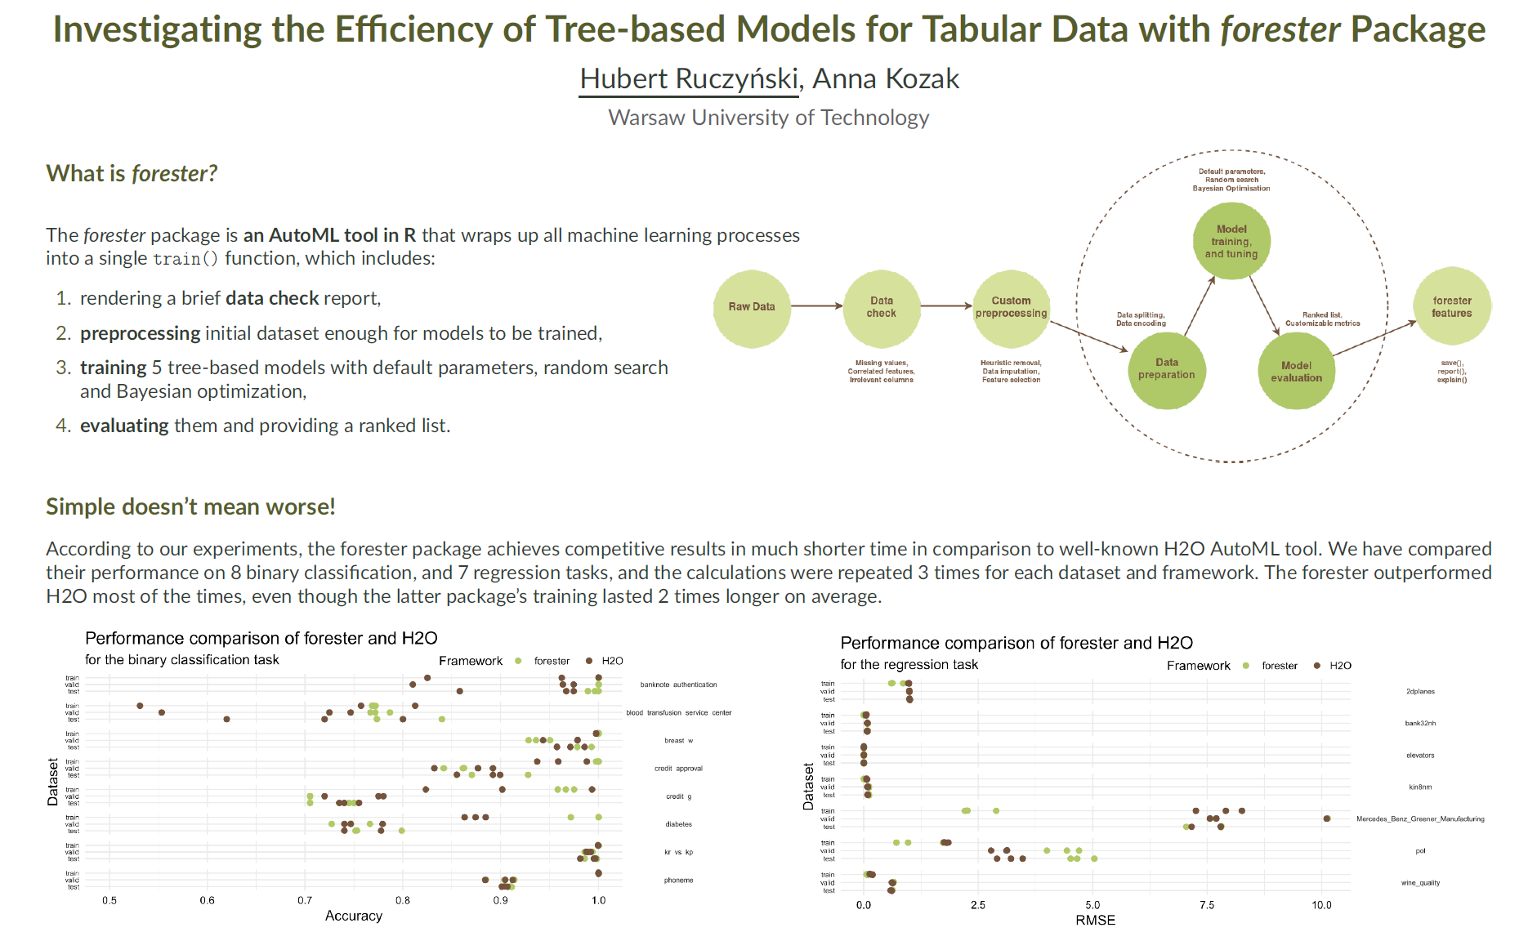

Slide 30
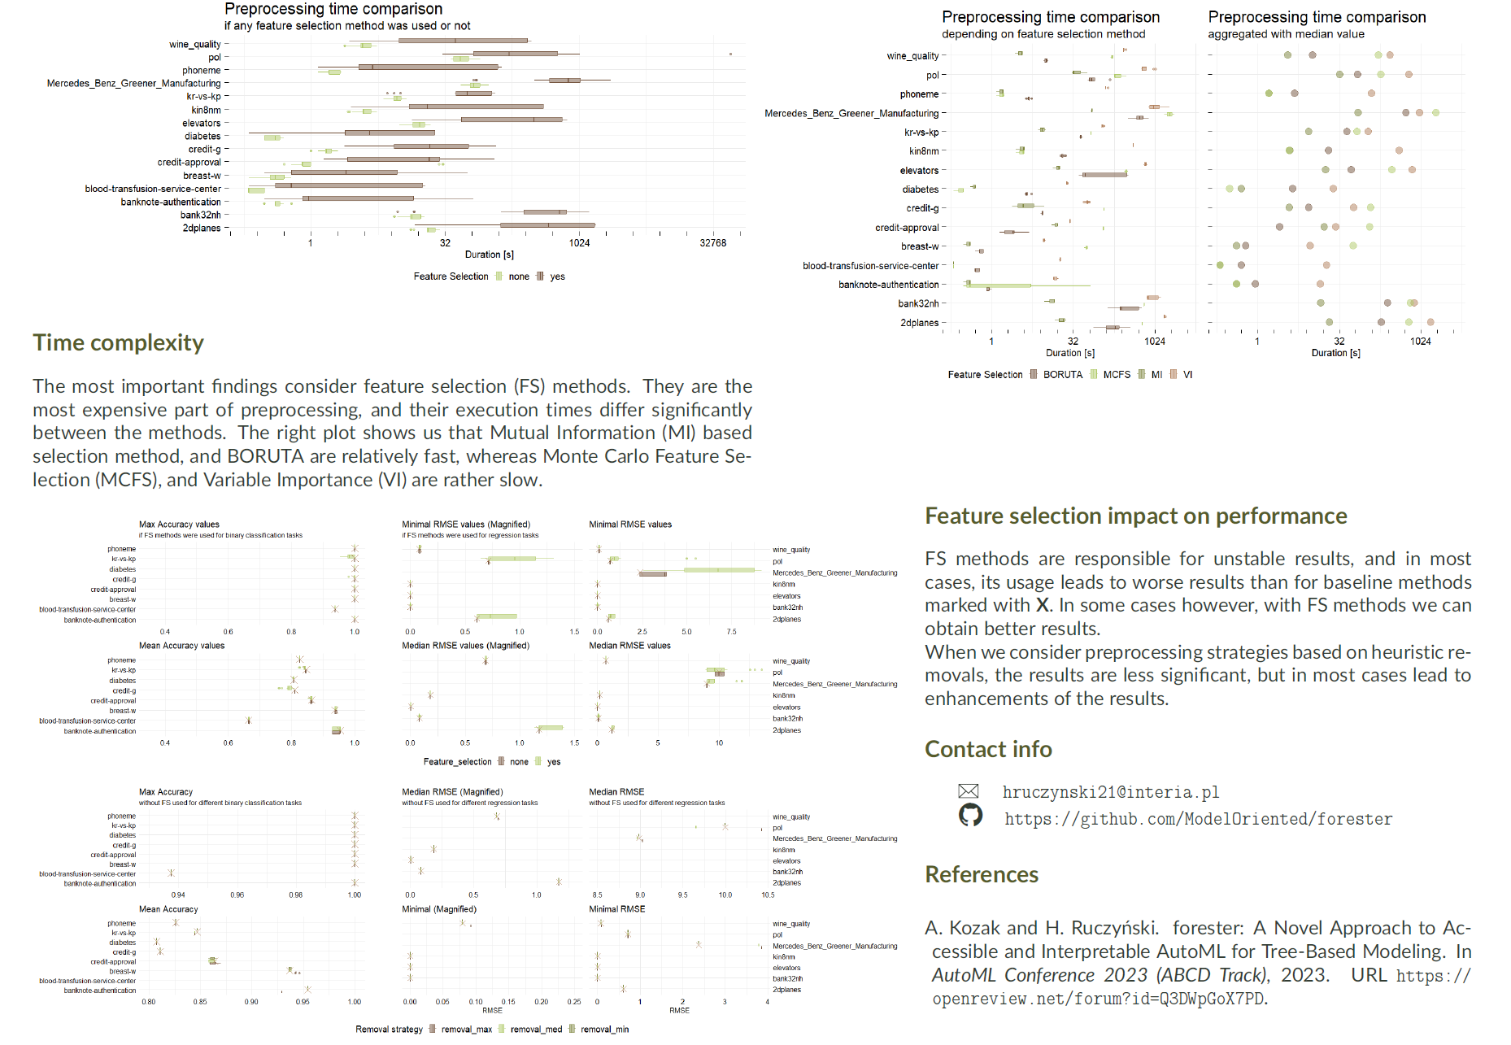

Slide 31
